Slide 1
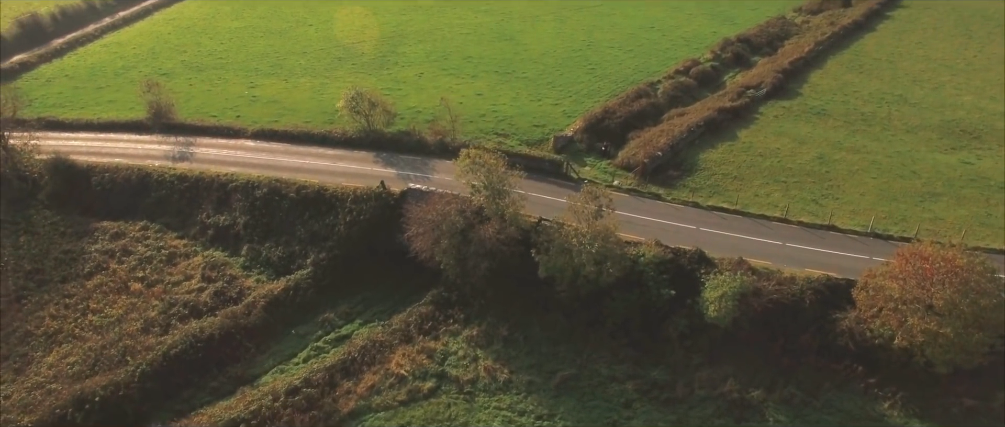
Tralee - Fenit Greenway
Keith Phelan
ITT Sustainable Tourism Seminar

Slide 2
Hello!
Friends of the Tralee - Fenit Greenway (GST)
Kerry Cycling Campaign
Kerry Bicycle Festival
Cyclist.ie (ECF)
Notes:
Involved in cycle advocacy in Kerry for over 10 year
Friends of TF 2009
KBF 2006 - 13 ( 6 years)
Caveats
Can’t look at TF without related routes
Cycle bias - walking similar but for daily distance covered

Slide 3
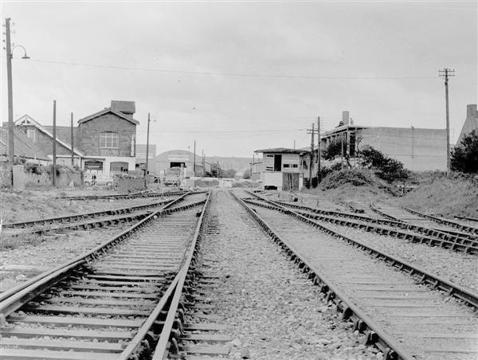
Playground !

Slide 4
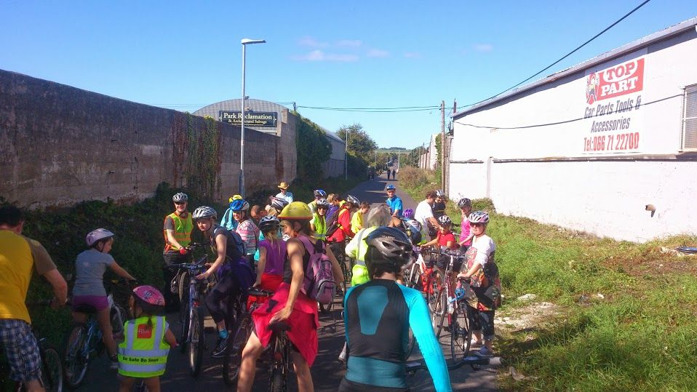
What is a greenway ?
Greenways can be defined as “open space or natural areas that have a linear form”
Smith and Hellmund, 1993.

Slide 5
What is a greenway ?
More generally a Greenway is a transportation route dedicated to non-motorised transport, mainly walking and cycling, but can also be used for other recreational activities, such as hiking, biking, in- line skating, jogging, running, and strolling.
They also provide a means of getting from home, work and school without the use of a car.
Greenways make communities more liveable;
improve the economy through tourism and civic improvement;
preserve and restore open space and encourage biodiversity;
provide opportunities for physical activity to improve fitness & mental health;
and enhance property values.

Slide 6
Greenway Tourism
Mayo €7.2 million to the local economy per year (?)
26% of all overseas tourists engaged in some level of hiking or walking (2.3 million tourists PA, spending an estimated €1.3 bn during their stay in Ireland)
451,000 overseas tourists took part in cycling activities.
Need for long distance, connected routes
Cycling is the new golf !
Move from Dept of Transport to Dept. of Tourism
Tralee - Fenit unique benefits beyond tourism
Recreation/utility/commuter cycling
Ownership situation

Slide 7
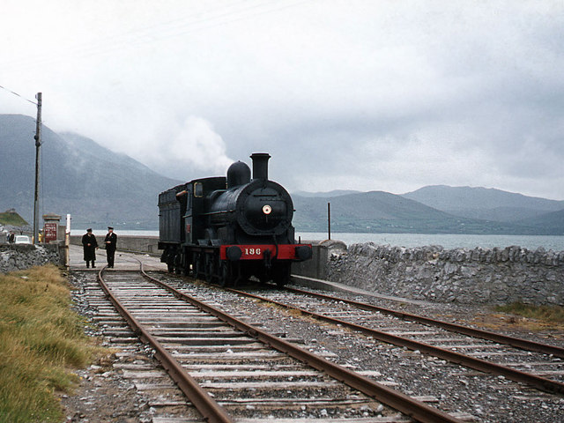
History of the
Railway(s)

Slide 8
History of the Railway
Tralee-Fenit
1887
The Tralee to Fenit railway was opened with grand ambitions of capturing some of the valuable Trans-Atlantic trade.
1935
Line is closed for regular passenger services, remains in use for goods traffic, the beat campaign as well as excursions and summer specials.
1978
Line is closed for all services.
2014
CIE issue abandonment order.
Notes:
Not abandoned due to CIE policy of maintaining strategic connections to ports
TF is closely linked to the NK line, both run parrell out of Tralee for ~3km

Slide 9
History of the Railway
North Kerry Line
1856 - 1880
Railway extended from Limerick
1963
Line is closed for regular passenger services, remains in use for goods traffic, the beat campaign
1977
Line is closed for all services.
1987
CIE issue abandonment order.
1988
CIE lift rails
Notes:
GWR reaches Tralee in 1859

Slide 10
1st
tourism project
Notes:
Great Southern Railway Preservation Society - Heritage Railway
1985 - 87
AnCo (FAS/Solas)
Resources transferred to Blennerville

Slide 11
History of the Railway
North Kerry Line
1856 - 1880
Railway extended from Limerick
1963
Line is closed for regular passenger services, remains in use for goods traffic, the beat campaign
1977
Line is closed for all services.
1987
CIE issue abandonment order.
1988
CIE lift rails
Railway Preservation Campaign
Notes:
GWR reaches Tralee in 1859
Railway action group, - keep the line intact
late 80’s rathkeale road widening / Listowel
Gave birth to the GST project

Slide 12
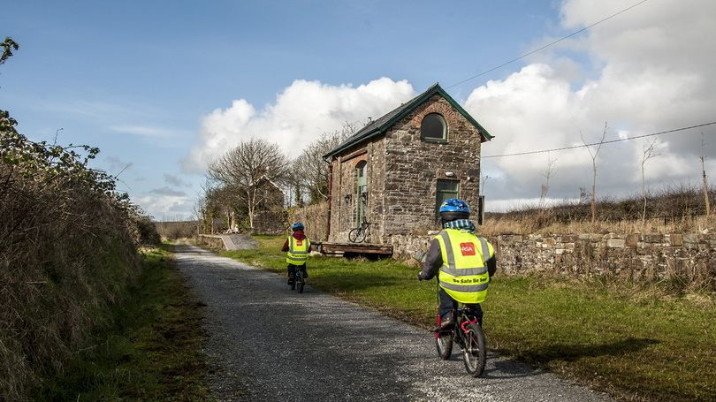
Great Southern
Trail

Slide 13
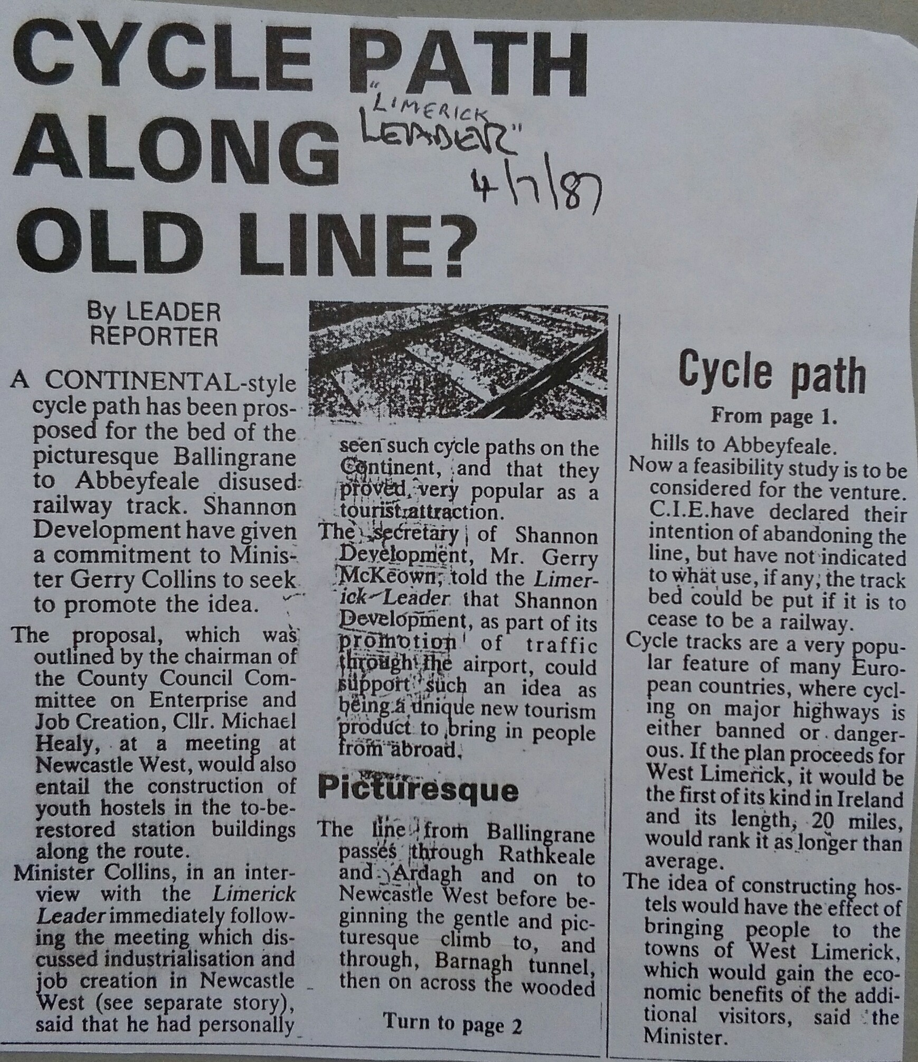
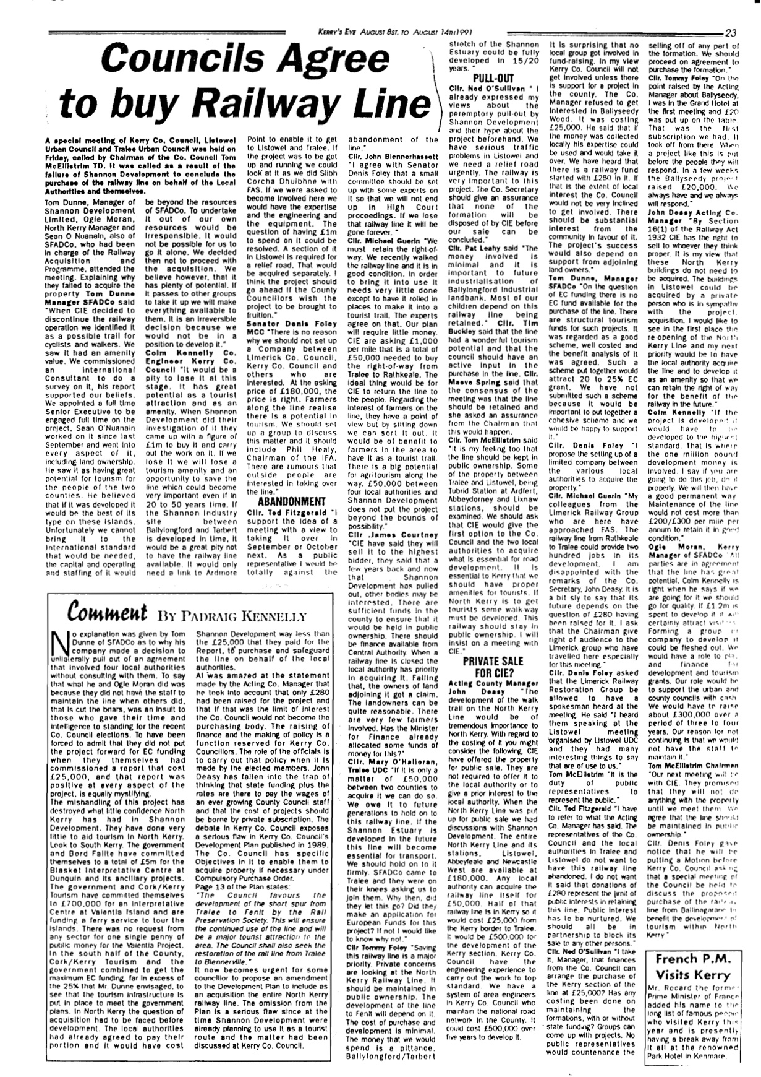
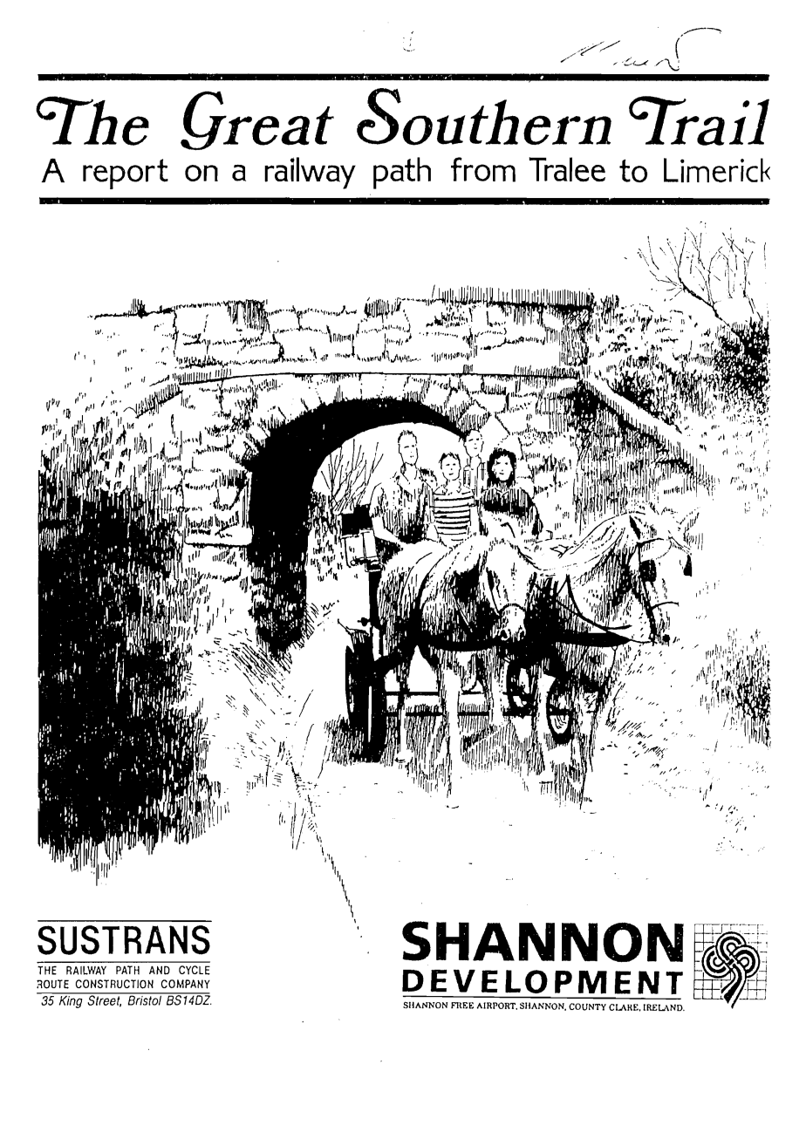
Great Southern
Trail
1987
Greenway ( Continental style cycle path) first proposed
1988
Shannon Development commission Sustrans (John Grimshaw) report
1991
Kerry CoCo Agree to purchase railway from CIE
Plan is shelved due to opposition
Great Southern Trail (GST) Group founded
Notes:
Sustrans manage/develop UK greenway network
Limerick Leader - 1987
Kerryseye - 1991
TF not included in Sustrains report due to heritage rail project, included in GST once abandoned

Slide 14
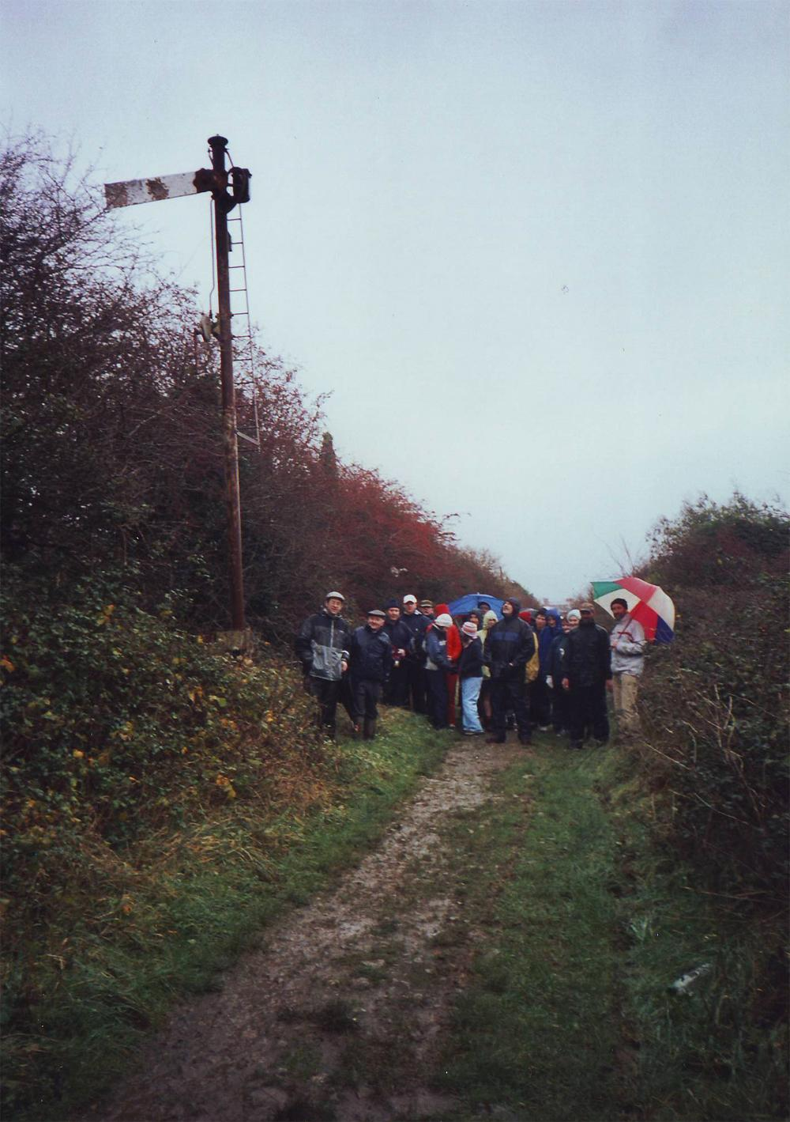
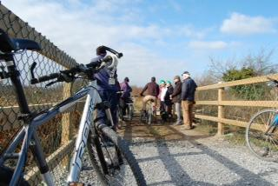
Great Southern
Trail
Organise walks
Fundraising
Lobbying
Licence from CIE
Opened 40km from Rathkeale - Kerry Border
European Greenway Association Awards
Management of Greenway passed to Limerick CoCo
Ultimately 85 km (Longest Greenway in Ireland)
Notes:
GST group walk Tralee (urban section) 2004

Slide 15
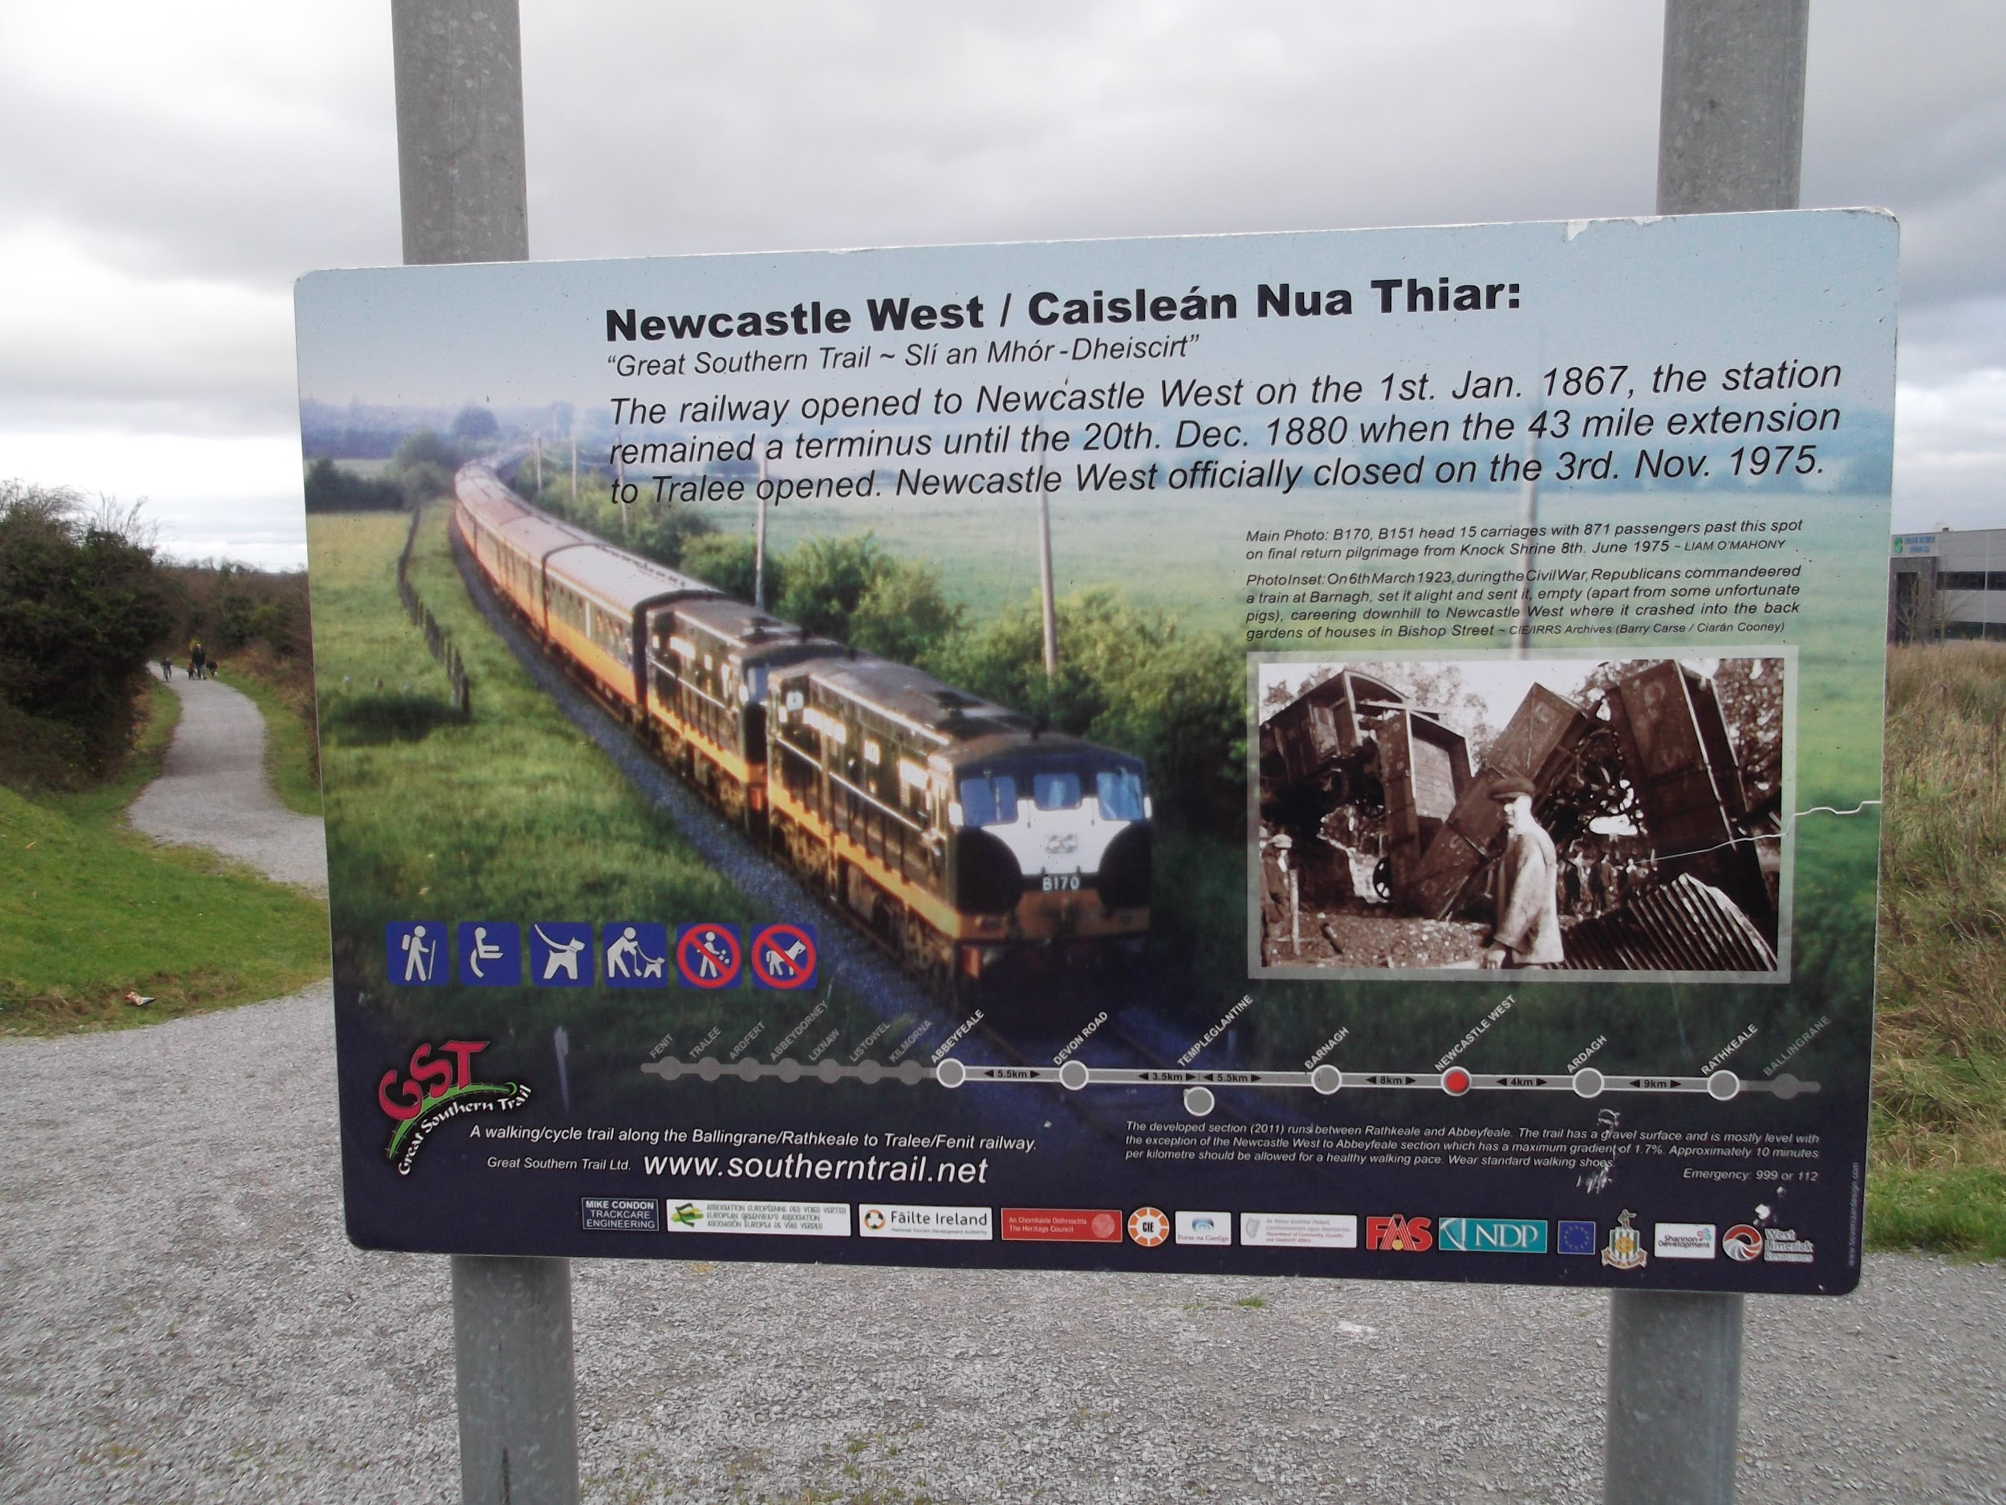
Great Southern
Trail
Fenit - Ballingrane
Notes:
GST group walk Tralee (urban section) 2004

Slide 16
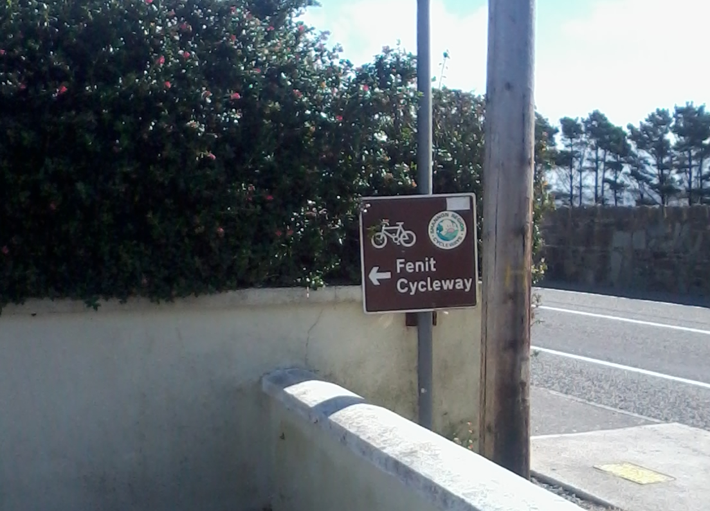
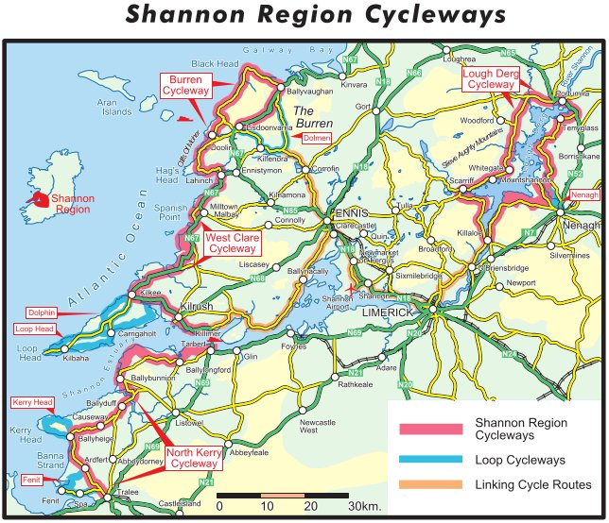
Shannon Region
Cycleways
/home/keith/Dropbox/tralee_fenit/fenit_shannon_cycleways/shannon_region_cycleways.jpg
Notes:
Failure
All that exist are the signs
Road routes != greenway

Slide 17
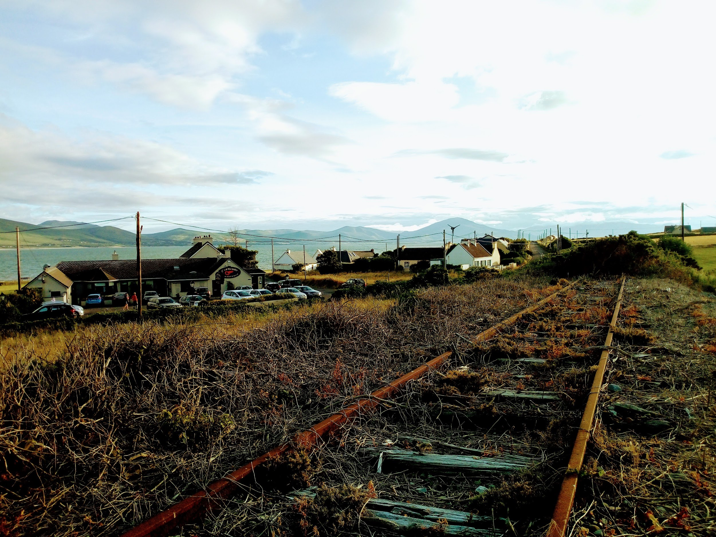
Tralee - Fenit
Greenway

Slide 18
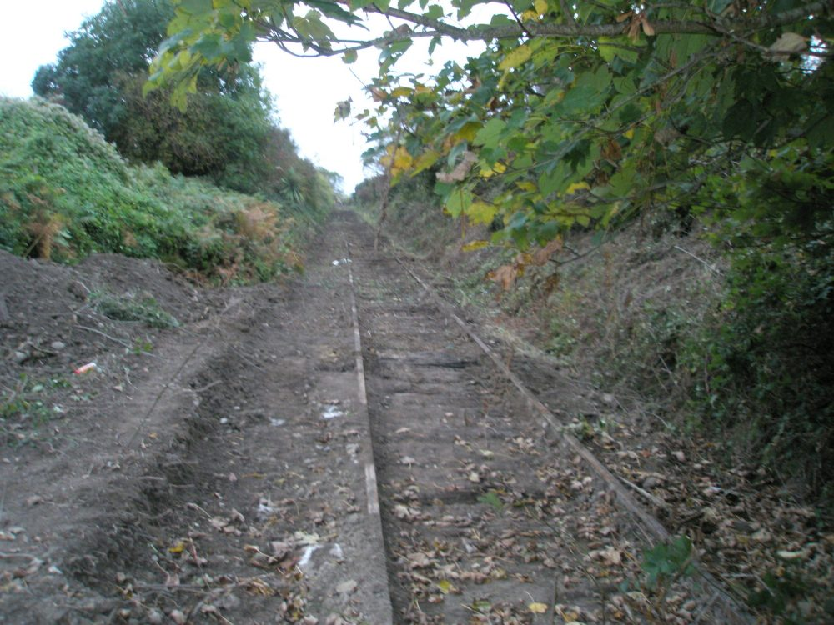
Tralee - Fenit Greenway
Timeline
2009
Spa/Fenit Community Council secure Leader funding in order to develop the Spa to Fenit section of the line
2010
Kerry CoCo begins route clearance
Work stopped due to objections/threats
2013
Rock Street to Mounthawk Tralee opened and is an immediate success.
2015
Rock Street to Casement Station opened.
2018
Part 8 planning for approved unanimously
Friends of the Tralee Fenit Greenway
Notes:
GWR reaches Tralee in 1859
Railway action group, - keep the line intact
late 80’s rathkeale road widening / Listowel
Gave birth to the GST project

Slide 19
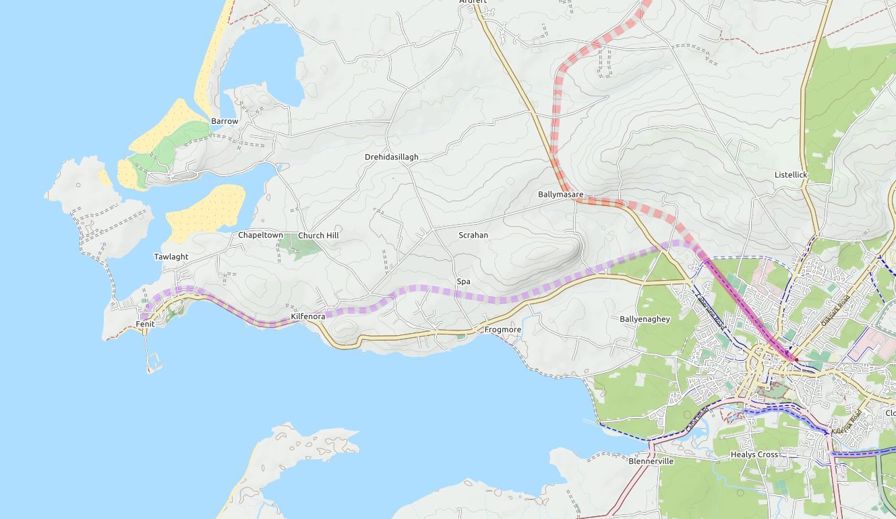
Tralee - Fenit Greenway
Route
From Casement Station in the heart of Tralee
to the Blue flag beach at Fenit
Notes:
GWR reaches Tralee in 1859
Railway action group, - keep the line intact
late 80’s rathkeale road widening / Listowel
Gave birth to the GST project

Slide 20
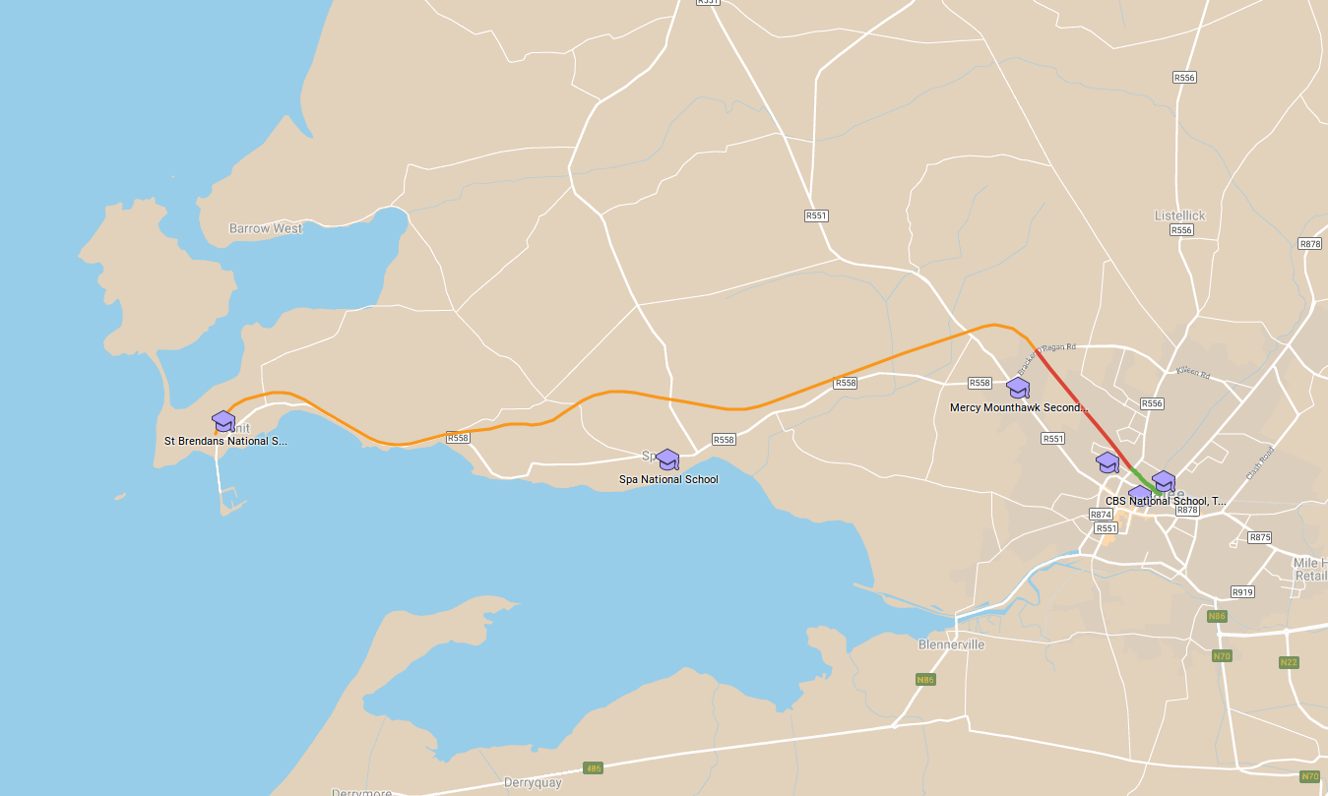
Tralee - Fenit Greenway
Route - School / Public Transport
NCPF
Obj. 4.1 aims to Provide
Cycling-Friendly Routes To All Schools
Obj. 8.1 aims to ensure proper integration between cycling
and public transport.
Notes:
Nation Cycle Policy Framework

Slide 21
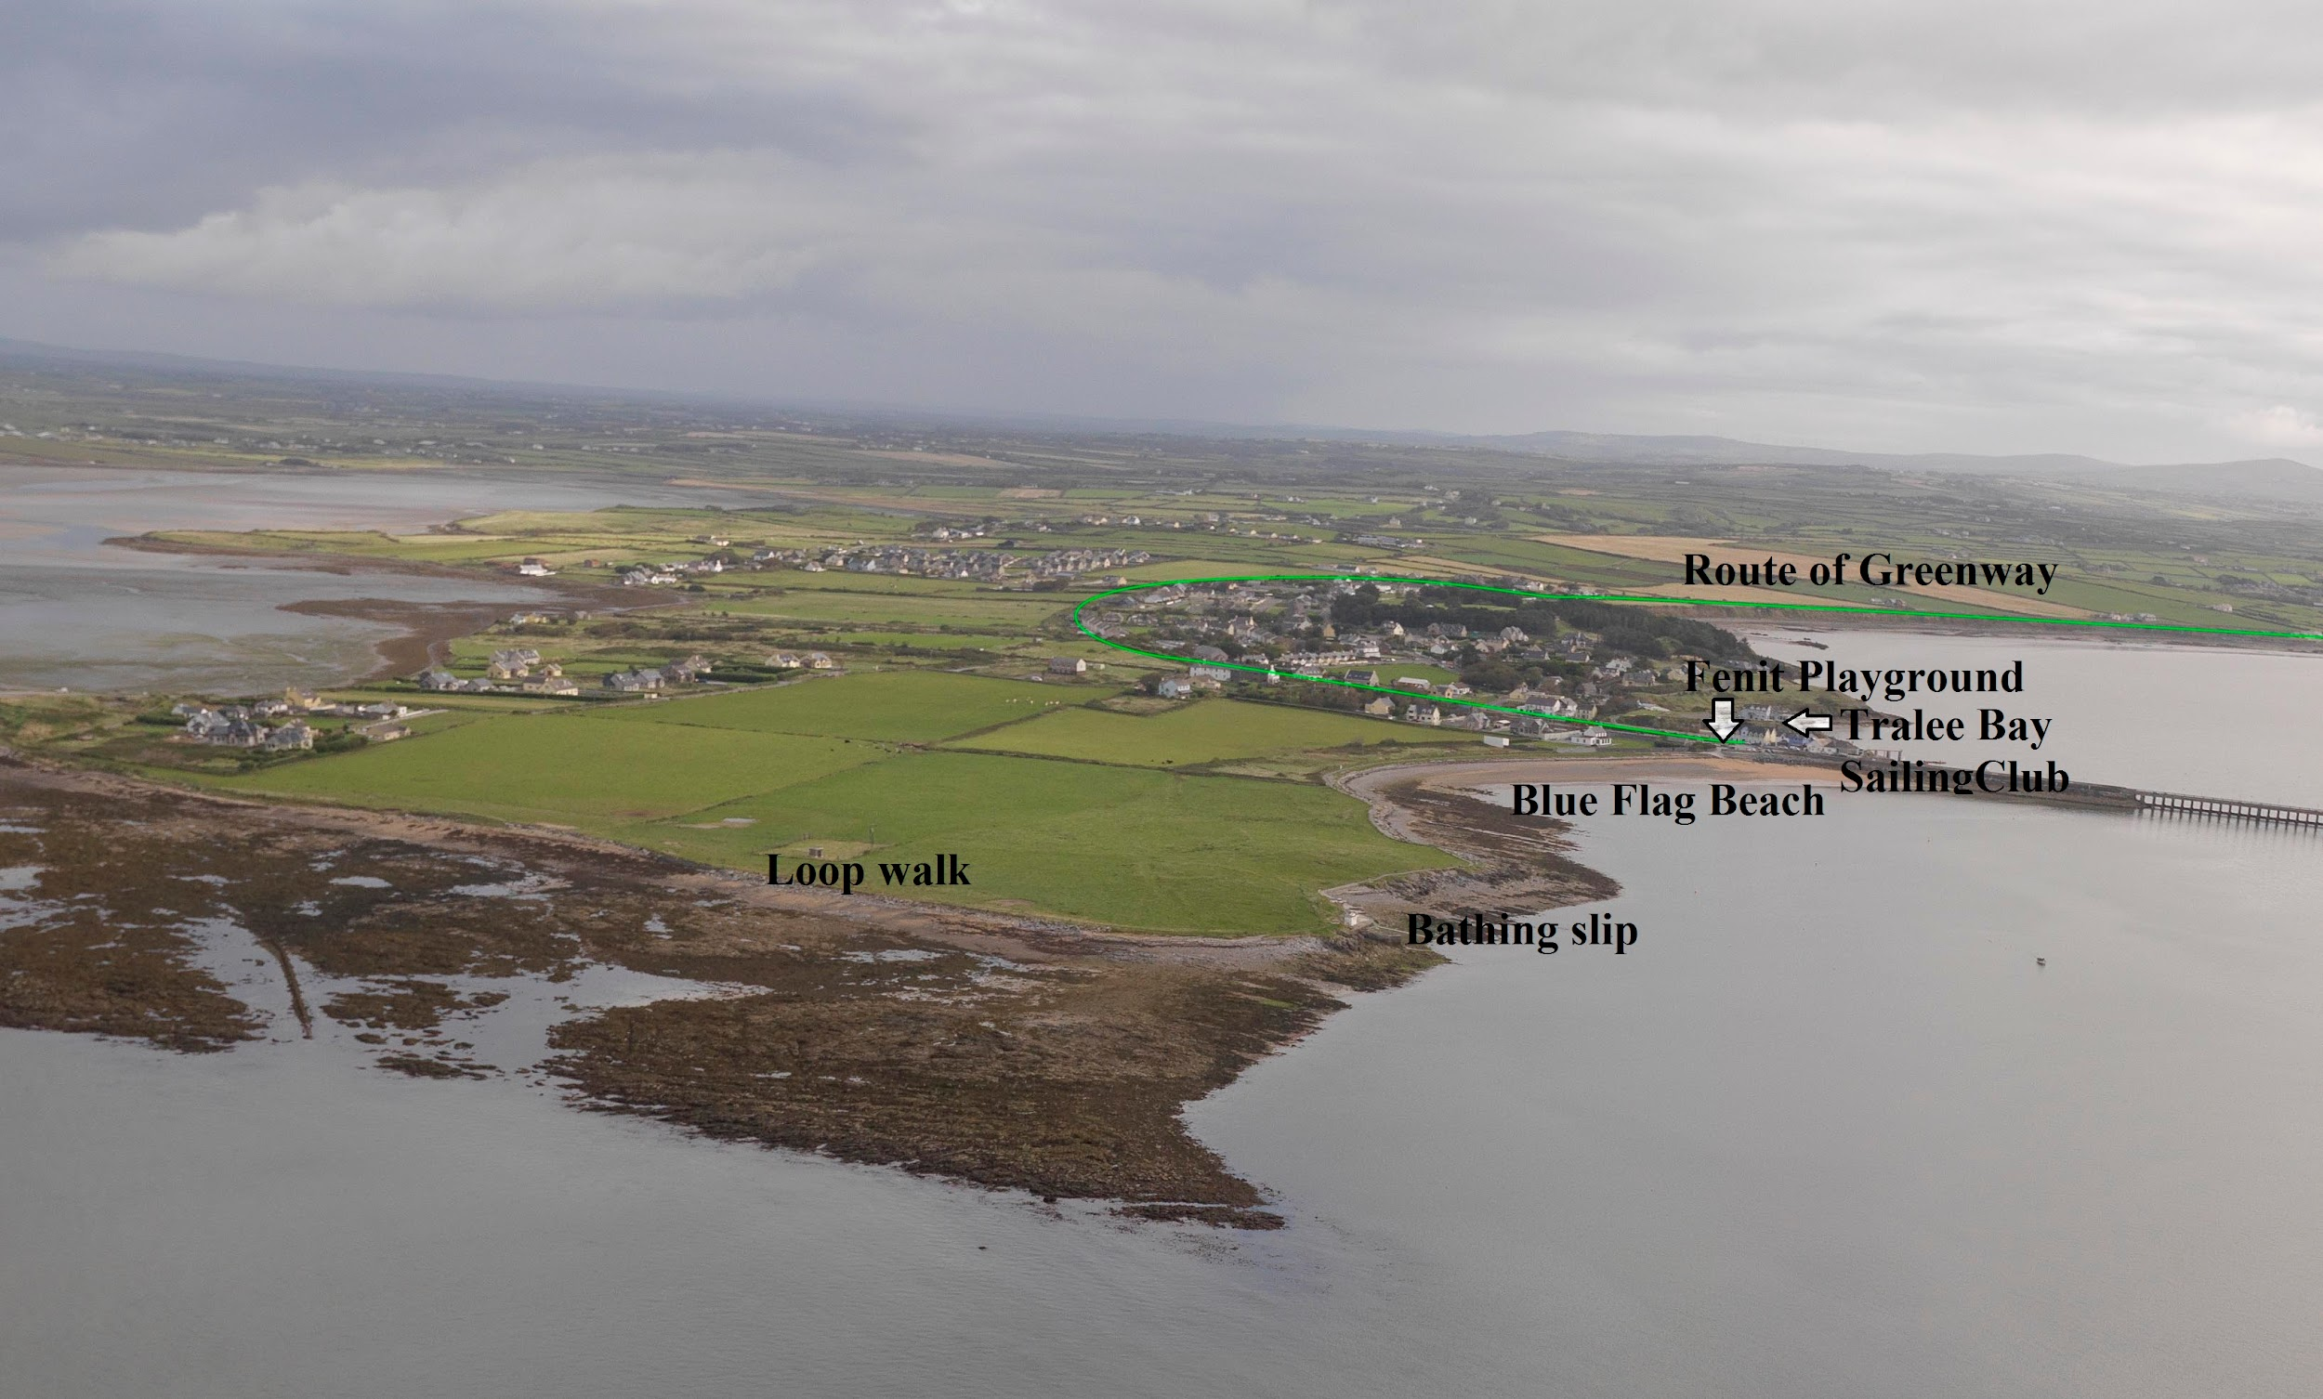
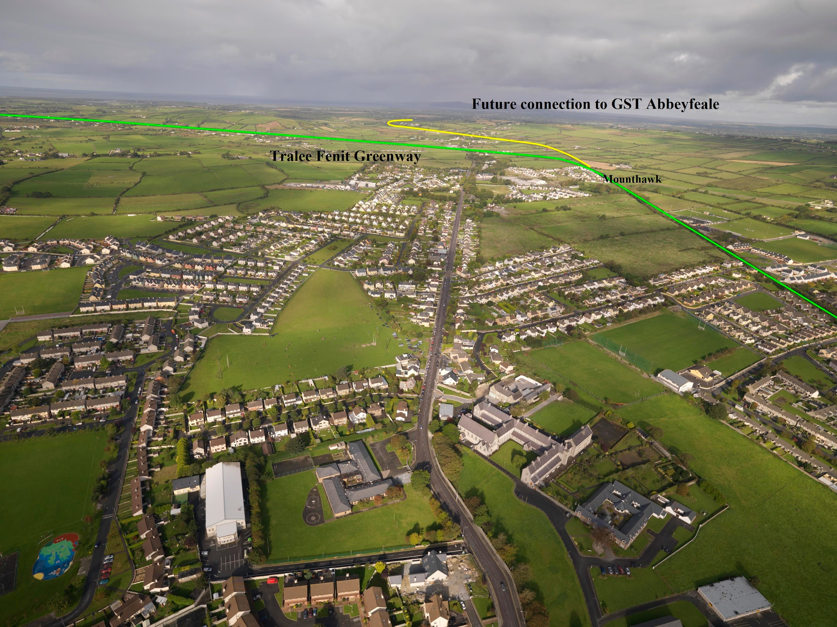
Tralee - Fenit Greenway
Aerial Views

Slide 22
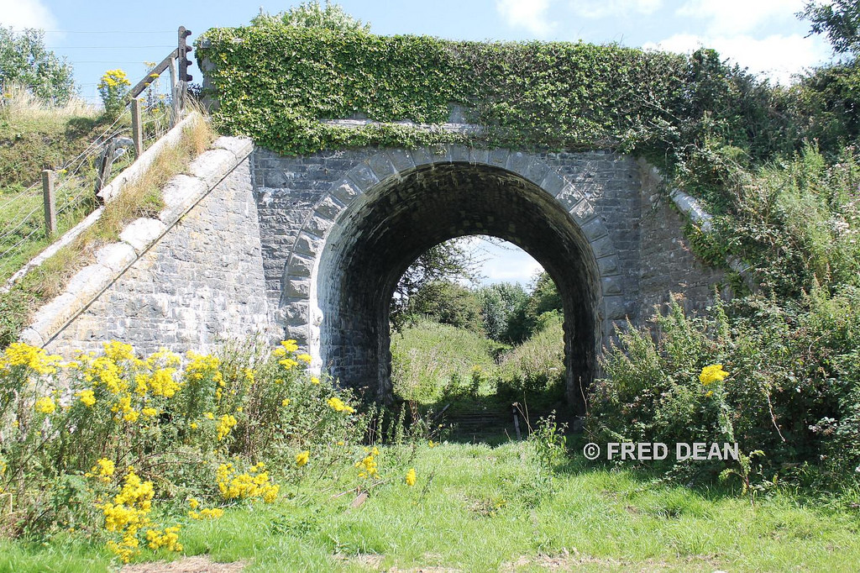
Part of a network

Slide 23
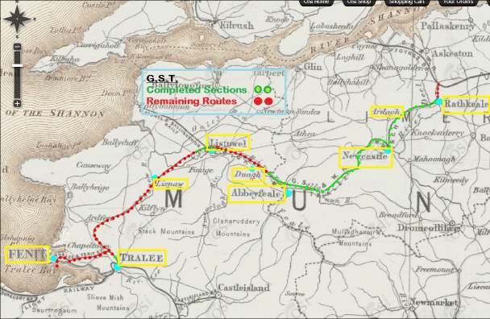
Great Southern Trail/Greenway

Slide 24
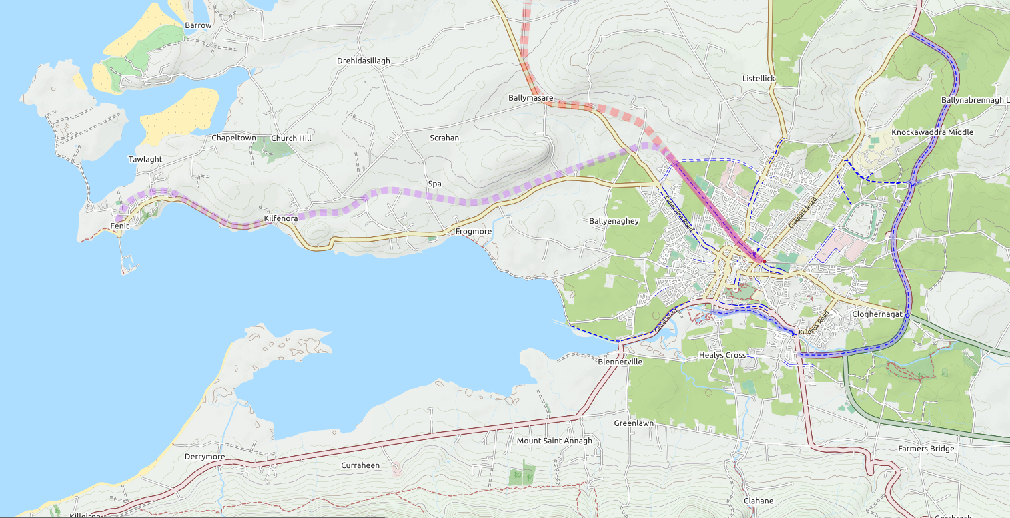
Tralee cycle network

Slide 25
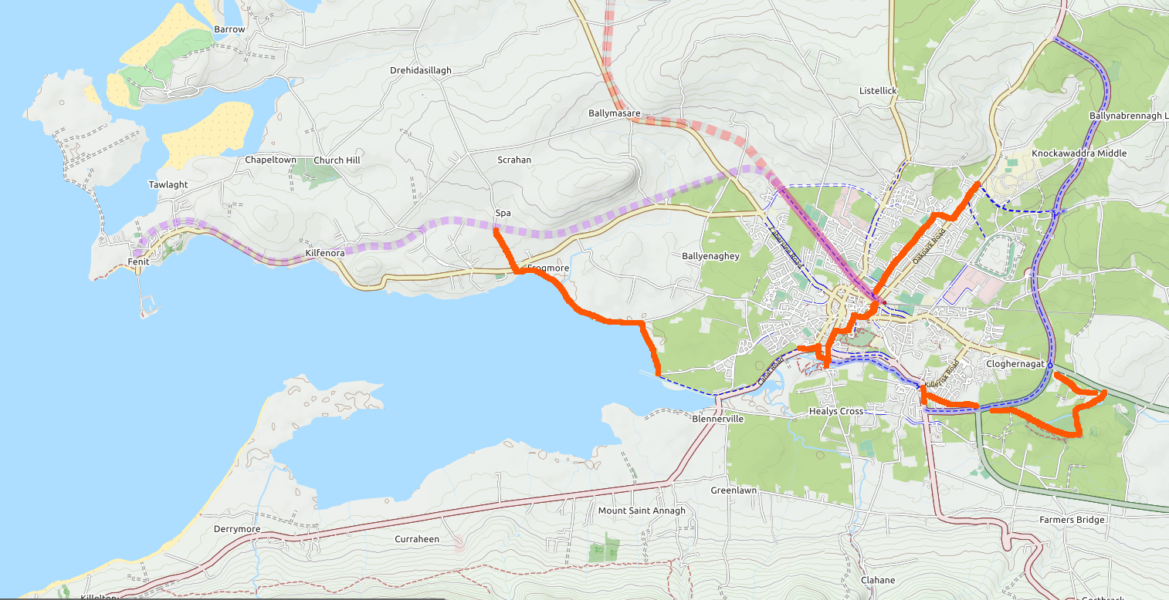
Tralee cycle network
future

Slide 26
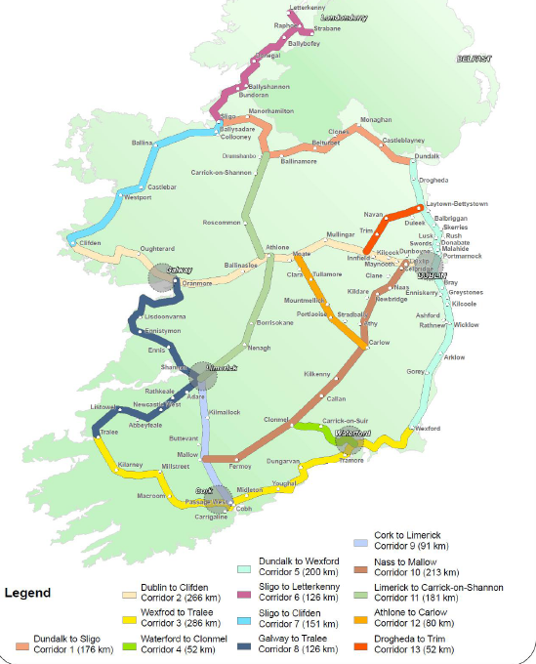
National Cycle Network
NCPF recognises the need to support and encourage all types of cycling, including recreational and tourist cycling. "Recreational routes", says the policy, "in and around urban areas, which in turn link to rural areas, are very important."

Slide 27
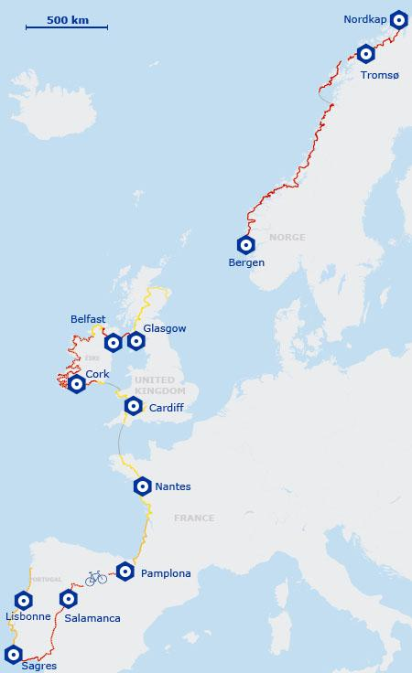


EuroVelo 1
The Atlantic Coast Route combines for around 9,100 km Following Europe’s mighty western border from Norway through the United Kingdom, Republic of Ireland, France, Spain and Portugal
Place your screenshot here

Slide 28
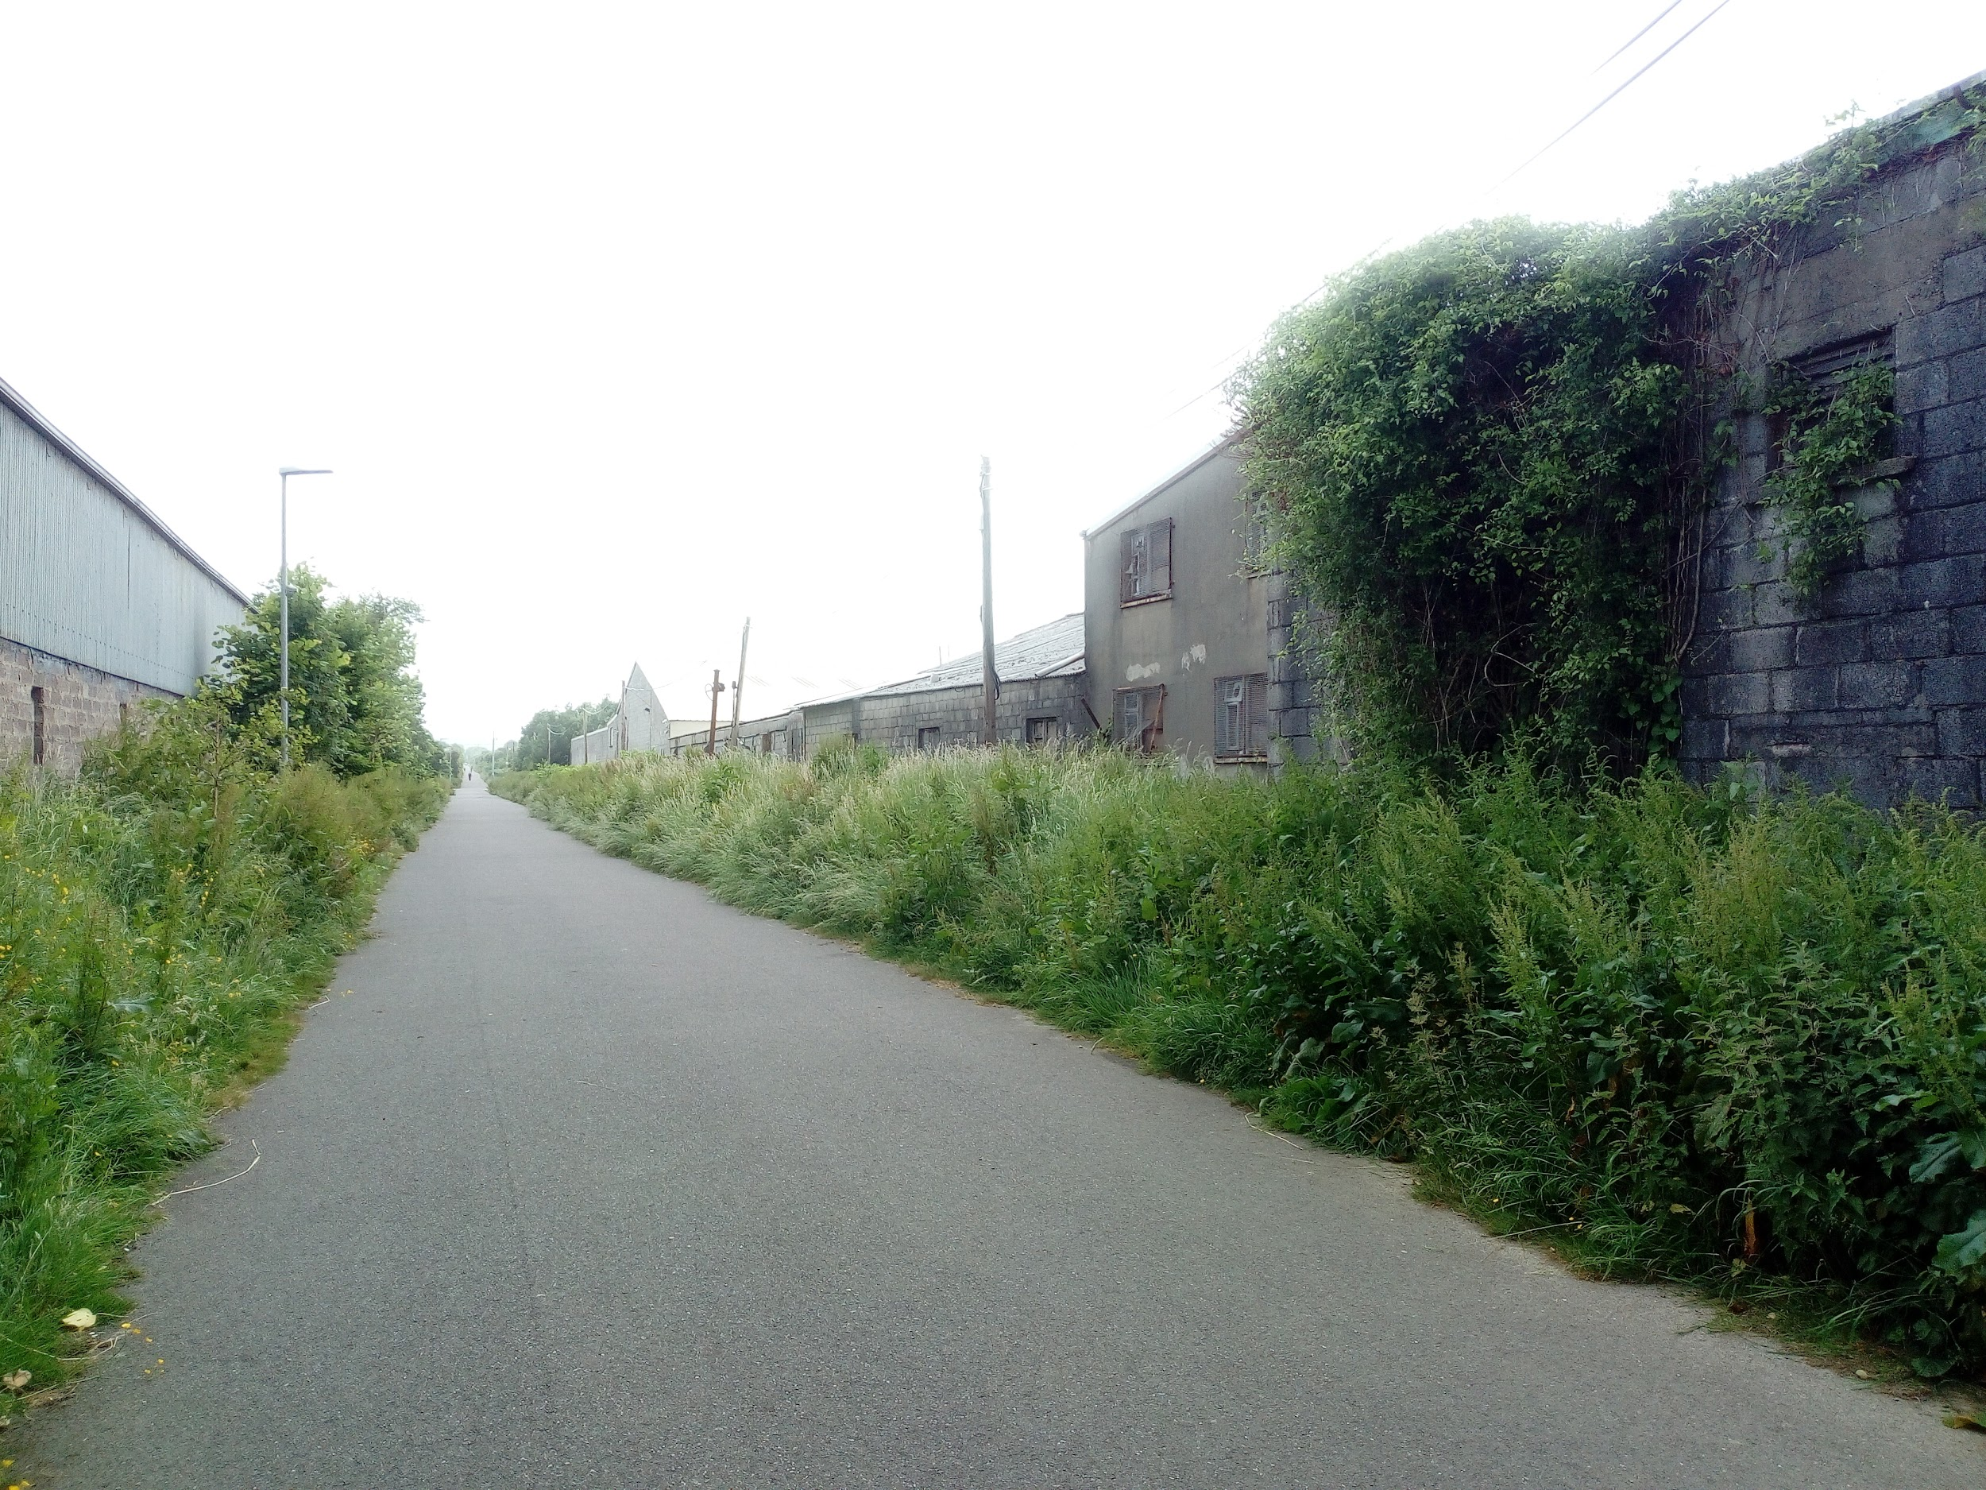


Community Orchard

Slide 29
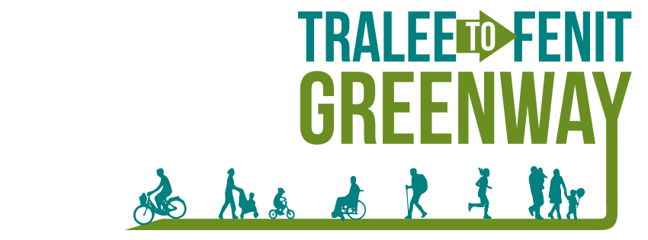
The best time to develop a greenway was 30 years ago.
The second best time is now.
Notes:
Chinese Proverb

Slide 30
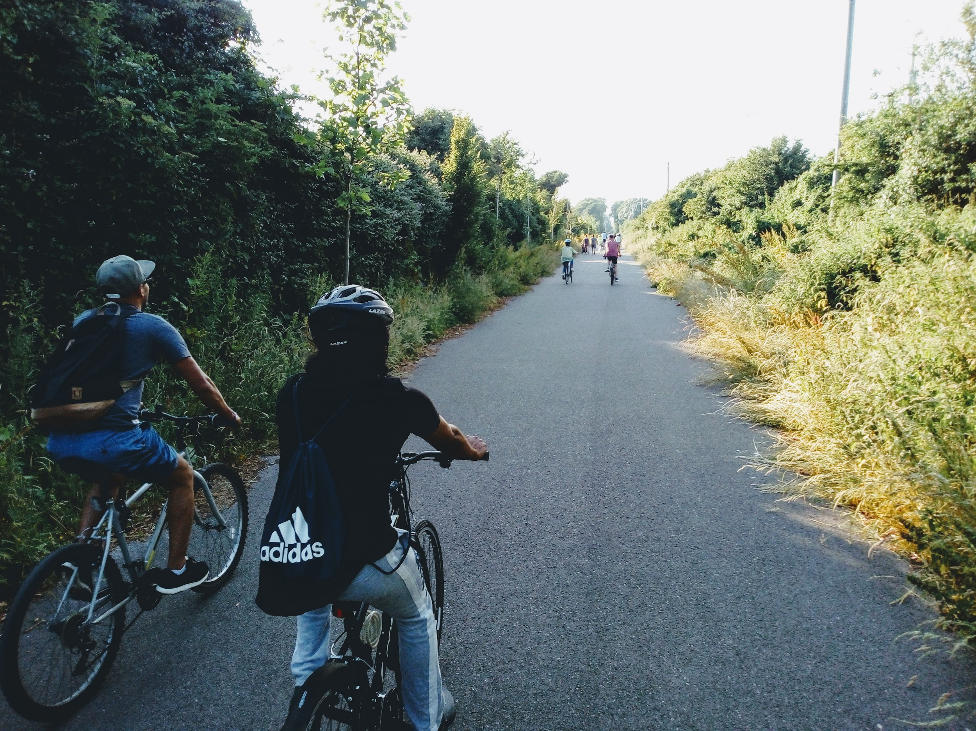
Thanks!
TraleeFenitGreenway.com
@traleefenit
/TraleeFenitGreenway

